Slide 1
Fanex.Logging
an Asynchronous Logging Library
Asynchronous Logging Library based on MSMQ

Slide 2
Agenda
Objectives of Fanex Logging
Technical view
Usage
Log Management
Retrospective & plan

Slide 3
Objectives
Building a reliable and asynchronous logging engine
Offer many logging targets (database, email, file, …, can be extended)
Centralize the log management (provide a backend page to monitor log)
Standardize logging methodology of all projects

Slide 4
Technical view
Logging Application Block
Application
Fanex Logging
MSMQ Trace Listener
Logging Application Block
Destination Queue
MSMQ Distributor Service
Logging Application Block
Application
Fanex Logging
MSMQ Trace Listener
Logging Application Block
Application
Fanex Logging
MSMQ Trace Listener
Email Trace Listener
Database Trace Listener
Logging Targets

Slide 5
Technical view
Log Writer
Logger
Create
Client
Log Entry
Fanex Logging
Map
Log Filter
Priority Filter
Log Enabled Filter
Category Filter
Category
Map
Trace Source
All Events Log Source
Not Processed Log Source
Error Log Source
Category Source
Category Source
Map
Trace Listener
Database
Email
Event Log
Flat File
Rolling Flat File
MSMQ
System Diagnostics
WMI
XML
Map
Trace Listener
Text Formatter
Binary Log Message Formatter
Custom Log Message Formatter
Logging Target (Database, Files, Email, …)

Slide 6
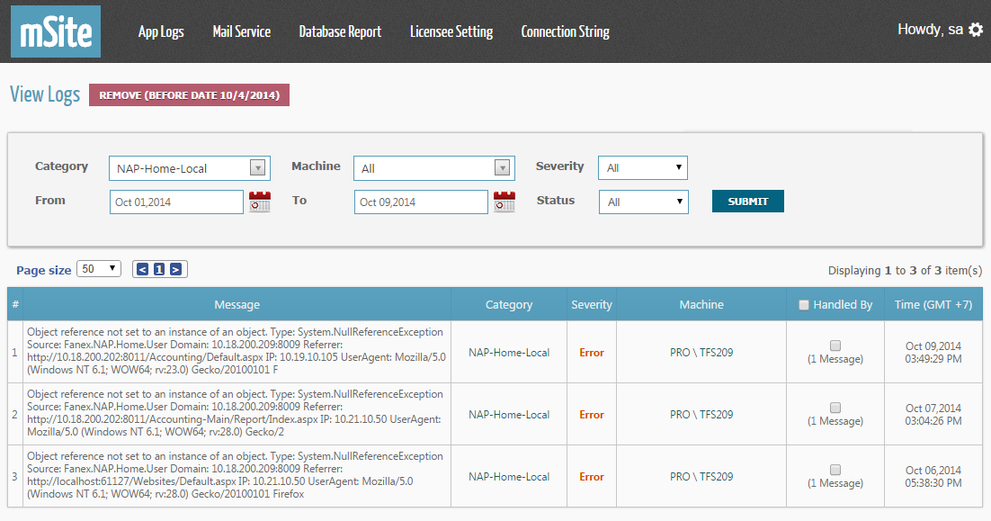
Log Management
Access App Logs/View Logs menu of mSite

Slide 7
Retrospective & Plan
Plan
Implement MongoDB as a custom logging target
Job auto clean old log data

